Slide 1
SUDHANSHU RANJAN
“SchoolSolver.com”
SUDHANSHU RANJAN

Slide 2
Earning a monthly salary of 15 lakhs is a significant goal and requires a strategic approach, especially with a Bachelor of Computer Applications (BCA) degree. Here's a roadmap to help you achieve this ambitious target:
1. Education and Specialization:
Excel in BCA: Ensure that you perform exceptionally well in your BCA program. Good academic performance is often a prerequisite for high-paying jobs.
Specialize: Choose a specialization within BCA that aligns with high-demand areas in the industry. Examples include data science, artificial intelligence, cybersecurity, or software development.
2. Certifications:
Industry-Recognized Certifications: Acquire relevant certifications that are recognized in the industry. For example, certifications in cloud computing (AWS, Azure), programming languages (Java, Python), or project management (PMP) can enhance your profile.
3. Build a Strong Portfolio:
Projects and Internships: Work on real-world projects and try to secure internships. Practical experience is highly valued by employers.
GitHub Profile: Contribute to open-source projects and maintain a strong GitHub profile to showcase your coding skills.
4. Networking:
Attend Conferences and Meetups: Attend industry conferences, seminars, and meetups to network with professionals. Networking can open up opportunities and provide insights into the industry.
LinkedIn Profile: Maintain a professional LinkedIn profile highlighting your skills, projects, and achievements. Connect with professionals in your field.
5. Soft Skills:
Communication Skills: Develop strong communication skills, both written and verbal. The ability to articulate your ideas is crucial in a professional setting.
Problem-Solving: Employers value individuals who can effectively solve problems. Develop a mindset for critical thinking and creative problem-solving.
6. Advanced Education (Optional):
Consider Postgraduate Studies: Pursue a master's degree in a relevant field if feasible and aligned with your career goals. Advanced degrees can sometimes open doors to higher-paying positions.
7. Job Search and Negotiation:
Research Salaries: Understand the salary ranges for your desired role and location. Websites like Glassdoor, LinkedIn, or Payscale can provide salary insights.
Apply Strategically: Target companies known for offering competitive salaries. Apply for positions that align with your skills and career goals.
Negotiation Skills: Develop strong negotiation skills. Be prepared to negotiate your salary based on your skills, experience, and the industry standard.
8. Stay Updated:
Continuous Learning: Stay updated on the latest technologies and industry trends. The tech industry evolves rapidly, and staying current is essential for career growth.
9. Consider Entrepreneurship:
Start Your Own Venture: Consider entrepreneurship if you have a unique business idea. Building a successful business can lead to significant financial rewards.
10. Financial Management:
Invest and Save: Once you start earning a substantial salary, focus on financial management. Invest wisely and save for the future.
Remember that reaching a monthly salary of 15 lakhs requires time, dedication, and continuous improvement. Be adaptable, stay persistent, and be open to seizing opportunities as they arise. It's also important to note that salary expectations can vary based on factors such as location, industry, and economic conditions.

Slide 3
Time Table (starts from 18th Dec to 14th Jan)
Day Shift (7:30 to 6:00)
Meditation is compulsory .
Gym from 8:00 to 9:30.
Basic routine 10:00 to 12:00.
Nap or Short Sleep.
Night Shift (7:30 to 2:30)
Basic Routine from 7:30 to 9:30
One full lecture and 15 minutes nap or short sleep.
Nap or short sleep is compulsory.
Target to Achieve is –
Peace full mid and High Intelligence Quotient level( per Day at least 15 minutes )
Correct Body posture with correct face structure (100 of everything Pushups, Squats, Pullups, Abs work)
Deep vocal cord voice (practicing Each day)
Per day one self improvement video( make video of per day work and read 5pages a day and self practice in mirror
Data Structure and Algorithm Completion ( Start from Starting from 0 to Hero and also try to practice code)

Slide 4
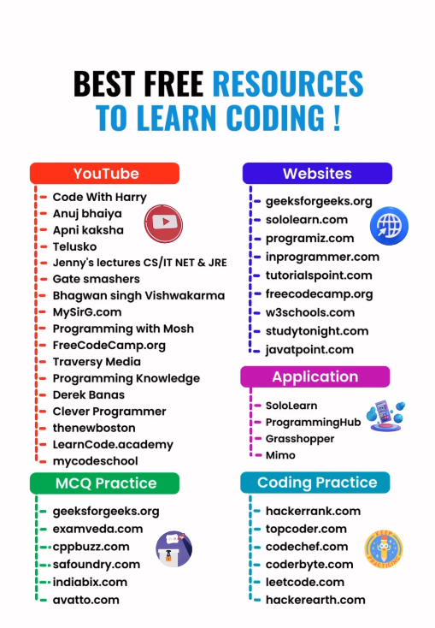
1ST PRIORITY
*** C & C++ & DSA
*** DBMS
*** NETWORKING
*** OPERATING SYSTEM
SOFT SKILL
ANALYTICAL

Slide 5
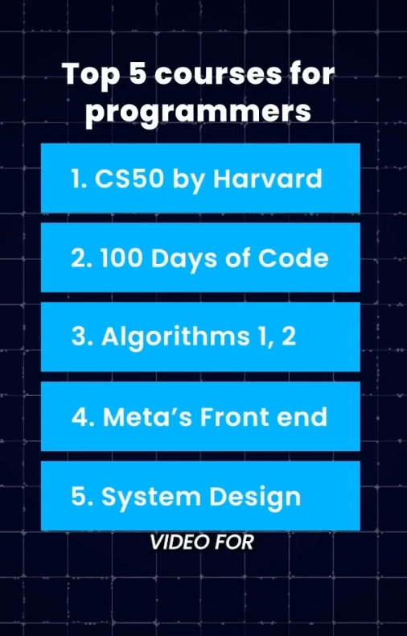
Your 1st priority
SOFT SKILL
ANALYTICAL
PYTHON
HTML,CSS AND JAVASCRIPT

Slide 6
STEP BY STEP
C LANGUAGE
C++ AND DSA LANGUAGE
HTML, CSS AND JAVA SCRIPT
SOFT SKILLS
ANALYTICAL
MICROSOFT TOOLS
DATA BASE MANAGEMENT SYSTEM
NETWORKING
OPERATING SYTEM
DAA
Excel

Slide 7
EARNING WEBSITES
NEXTLEVEL (START UP ME JOIN )
TRYMATA.COM
NEXT LEVEL : UNLOCK KUDOS AND JOBS { JOB FINDING APP}
GITHUB.COM ( INTERVIEW PREPARATION)

Slide 8
How to overcome laziness
Watch youtube videos
A. HOW TO BE MORE DISCIPLINE
B. JORDAN PETERSON: HOW TO STOP TO BEING UNDISCLIPLINED
C. NEUROSCIENTIST : TRY IT FOR 1 DAY ! YOU WON’T REGRET IT
D. STEVEN BARTLETT REVEALS : HOW TO BUILD UNBREAKABLE DISCIPLINE
E. KILL YOUR LAZINESS

Slide 9
IMPROVE VOCAB BY USING THESE YOUTUBE CHENNALS
3 HOURS ENGLISH MASTERCLASS: PRONUNCIATION ,VOCAB ,GRAMMAR
30 DAYS OFTO ENGLISH POWERFUL VOCAB
VOCAB A TO Z SERIES
WORD POWER MADE EASY BY LEWIS VOCAB
ENGLISH VOCAB 1000 + WORDS FULL CONCEPT

Slide 10
REMOTE JOBS (HOWTOSTARTANLIC.COM/BUSINESSIDEAS{FOR BUSINESS IDEAS})
JIO CAREERS
WE WORK REMOTELY
REMOTE.CO
JUSTREMOTE.CO
FLEXJOBS (****)
WELLFOUND
HIMALAYAS.COM

Slide 11
BOOKS YOU WANT TO DOWNLOAD (WEBSITE)
LEBGEN.IS ( THIS IS THE WEBSITE NAME)

Slide 12
For experience you can visit this website
Forage ( isme h ki tum company ke projects karke you can get experience certificate)

Slide 13
APPS TO EARN MONEY
SWAGSBUGS PLAYGAMES + SURVEYS
POLL PLAY: Earn MONEY REWARDS

Slide 14
This is the site where you can make notes through real time conversation
THE WEBSITE NAME IS (TAKE NOTES FOR ME)…

Slide 15
TOP WAYS TO CHANGE MYSELF
WRITE FOR AT LEAST 10 MINUTES ON ANY TOPIC
What matters most in life?
What do I really want?
How do I define success?
what motivates me?
What inspires me ?
Do the right people surrounds me?
Setting personal growth goals.
personal development?
Read biographies
Wake up at 4:30 atleast.

Slide 16
Master communication skills
How to speak so that people want to listen {(Julian Treasure) youtube}
6 Tips to speak attractively ( youtube psychology in hindi channel)
Last “100 years of communication skills ( youtube by Aditya raj kshyap)

Slide 17
BOOKS I HAVE TO READ.
1. 12 RULES FOR LIFE BY JORDAN PETERSON
2. STEALING FIRE BY STEVAN KOTLER
3. OHSO ASHTAVAKRA MAHAGITA VOL 1 AND 2
PSYCHOLOGY OF MONEY
ATOMIC HABITS
REWORK
THE SUBTLE ART OF NOT GIVING A FUCK( BY MARK MASON)
TOOLS OF TITANS(TIM FERRISS)
AUTOBIOGRAPHY OF YOGI
THE ART OF SIPLE LEARNING
HOW TO LISTEN WITH INTENSION
HOW TO TALK TO ANYONE
HOW THE BEST LEADER LEADS BRAIN TRACY *****
HOW TO WIN FRIENDS AND INFLUENCE PEOPLE
Feel the fear and do it anyway
Attitude is everything
Thinking fast and slow

Slide 18
HOW TO SPEAK SO THAT PEOPLES WANTS TO LISTEN
H HONESTY BE CLEAR AND STRAIGHT
A AUTHENTICITY BE YOURSELF
I INTEGRITY BE YOUR WORD
L LOVE WISH THEN ALL

Slide 19
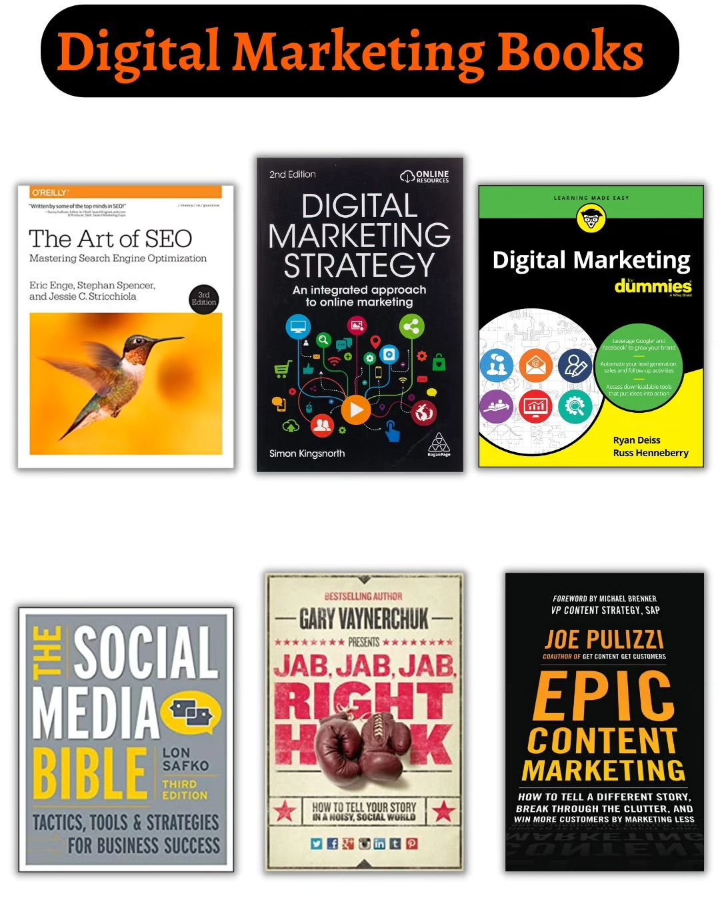
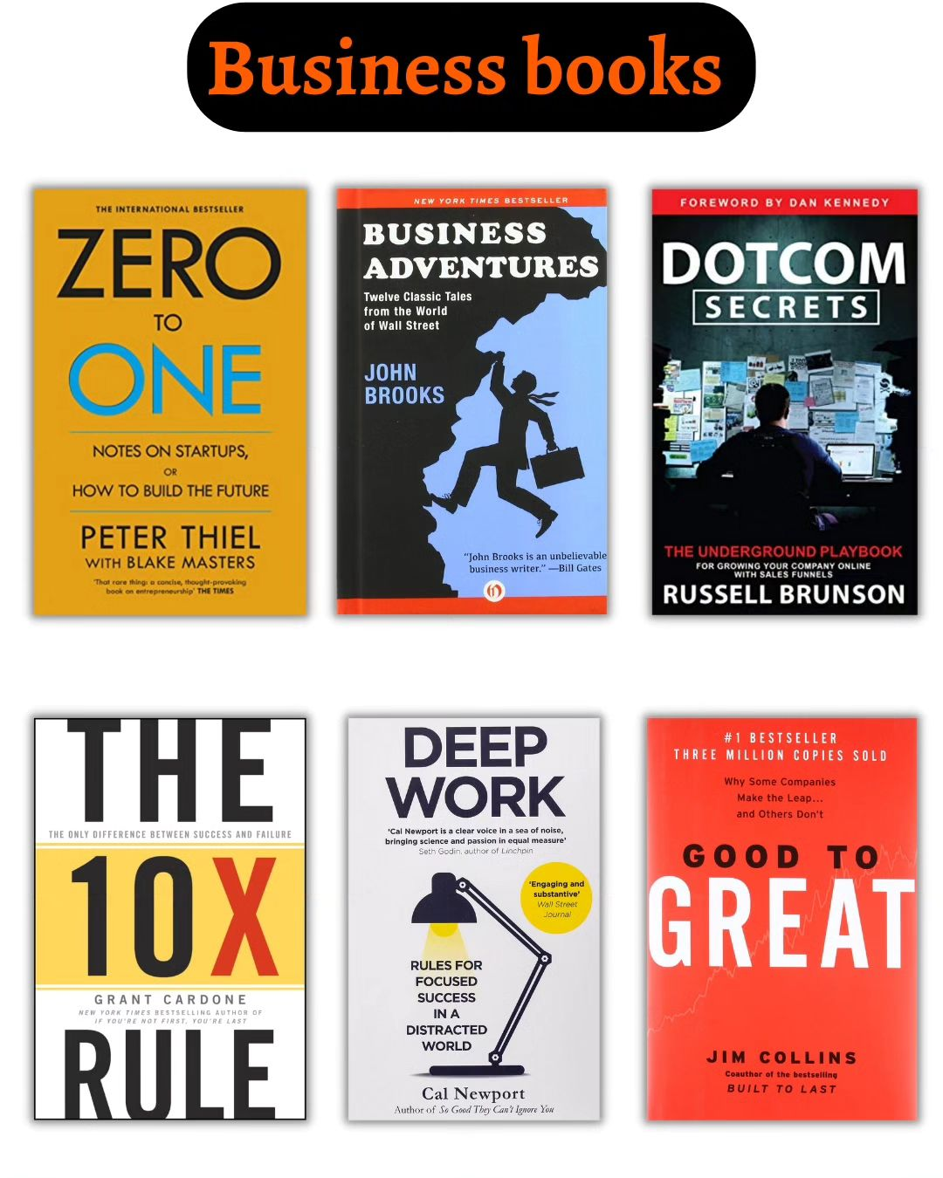

Slide 20

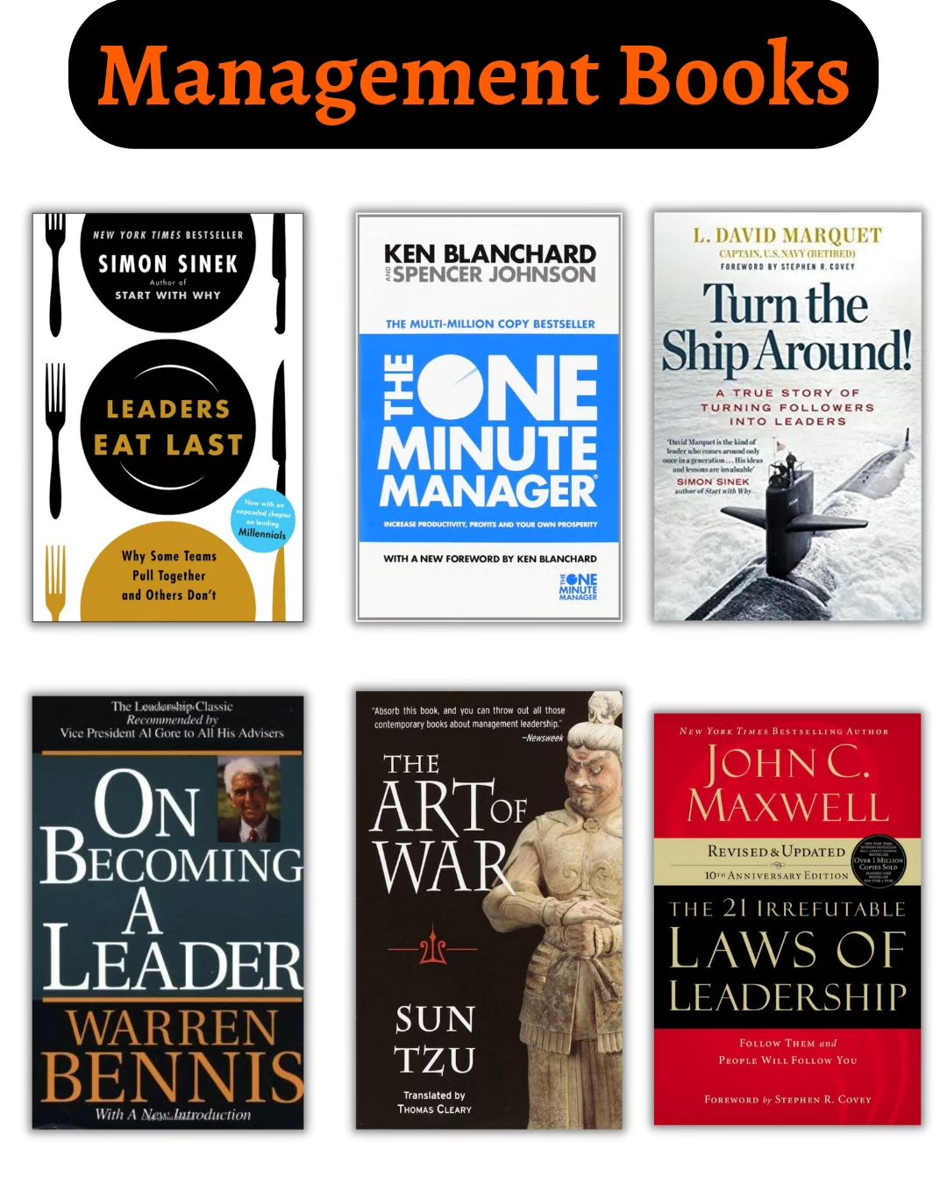
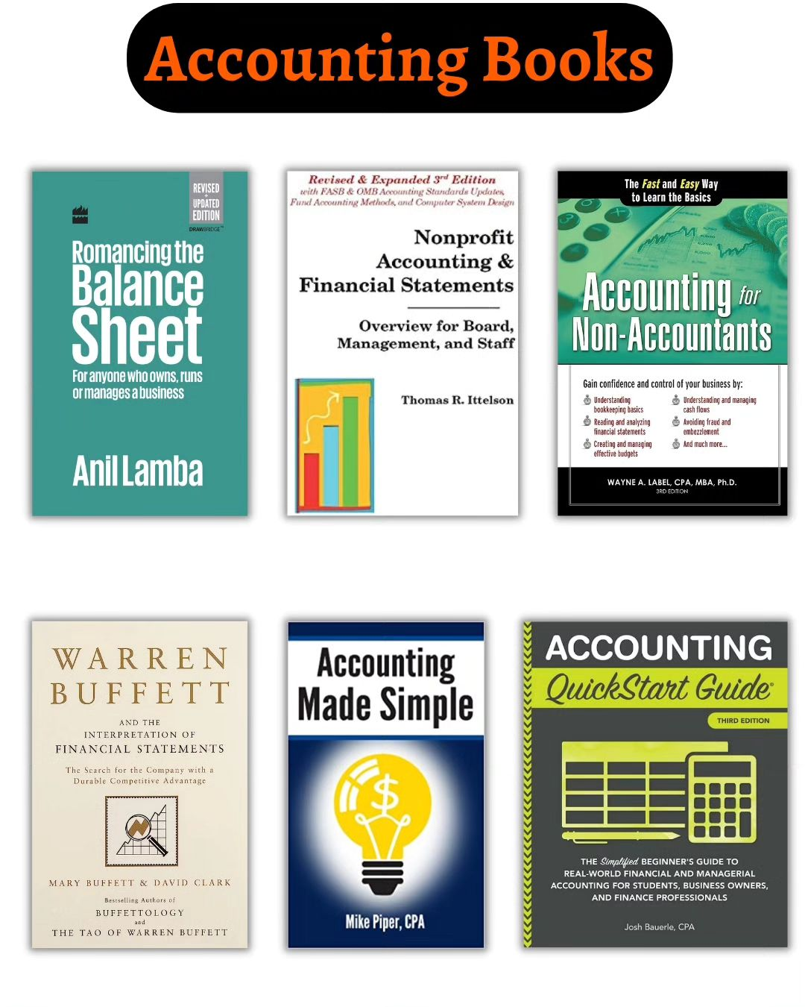



Slide 21
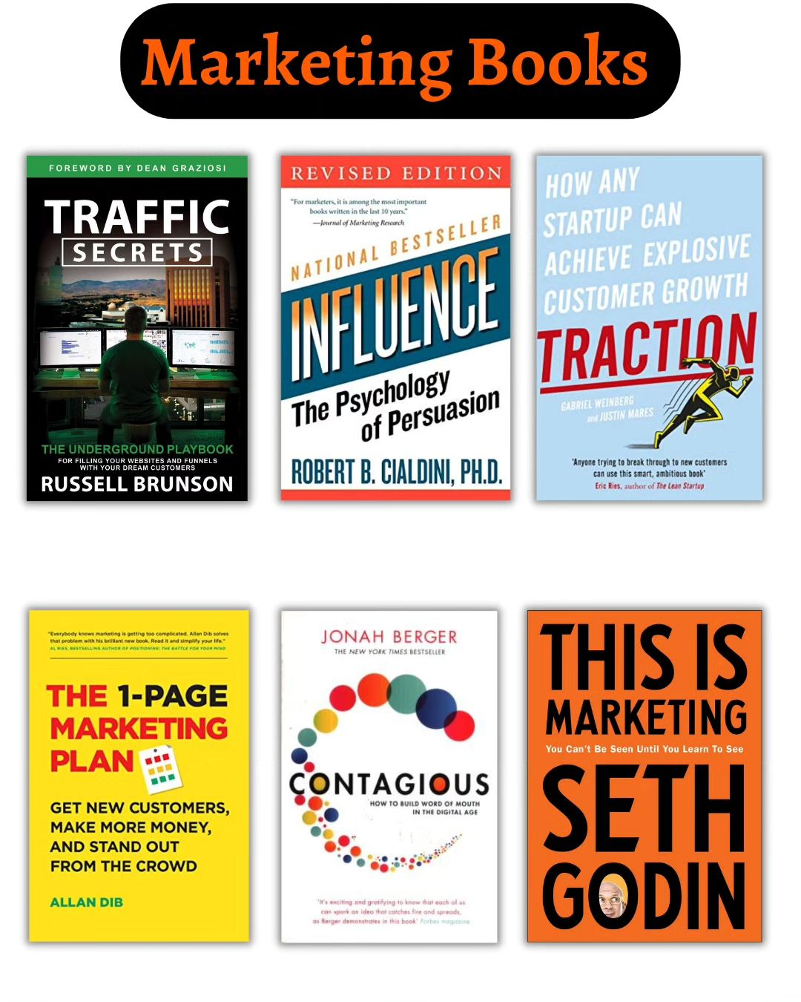


Slide 22
Ideas
Content Creation: Become a content creator on platforms like YouTube, TikTok, or Instagram, and monetize through ads, sponsorships, and merchandise.
. Telehealth Services
Overview: With the rise of remote healthcare, telehealth platforms connect patients with healthcare professionals via video calls and messaging.
Why It’s Successful: The demand for accessible healthcare has surged, especially post-pandemic.
Accessibility: Requires minimal setup; can be started with a website and a partnership with healthcare providers.

Slide 23
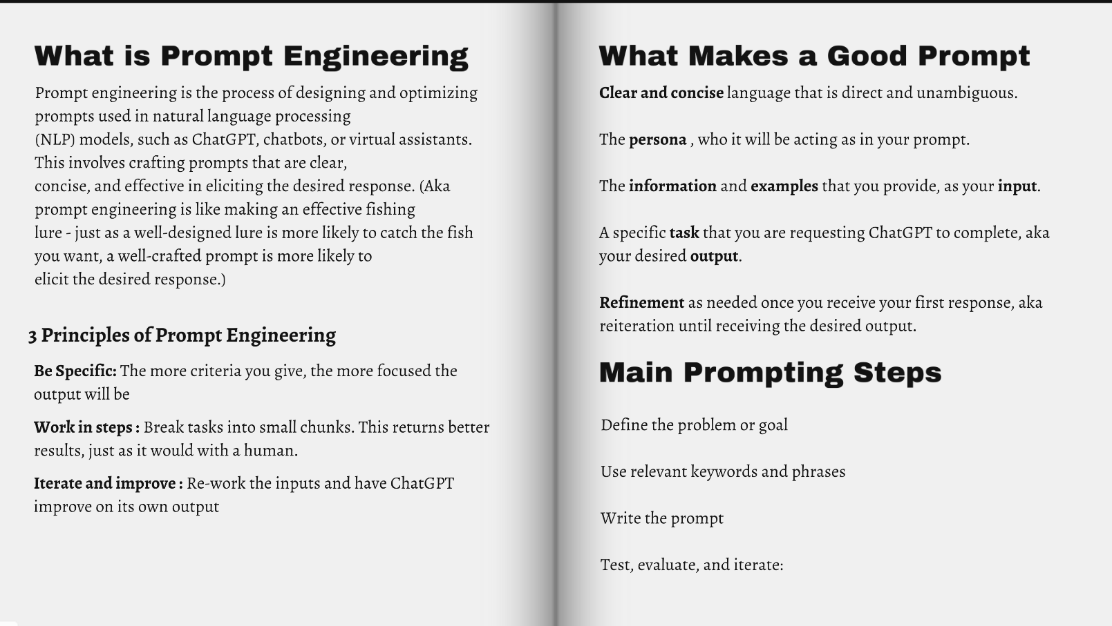

Slide 24
Ideas
Fitnss Trainer: Become a personal fitness trainer and offer sessions either in-person or online. You could also specialize in a particular area, like yoga or pilates.
Event Planning: Offer event planning services for weddings, parties, and corporate events. Helping people plan their big events can be both fun and rewarding.

Slide 25
Ideas
Reclaim.ai
Overview: A smart calendar companion that automatically schedules tasks for users, optimizing their time management.
Founded: 2019
Location: Portland, Oregon
Funding: $6.3 million
Website: Reclaim.ai

Slide 26
Ideas
Fetch Rewards
Overview: A mobile shopping app that rewards customers for purchasing their favorite items.
Founded: 2013
Location: Madison, Wisconsin
Funding: $341.85 million
Website: Fetch Rewards

Slide 27
Idea ka Tarika:
Team ka Gathan: Aap ek aisi team tayar karna chahte hain jismein skilled aur qualified log hon, jo candidates ko select karne mein madad kar sakein.
Company se Seedha Sampark: Companies aapse seedha sampark karengi, jisse unhe candidates dhoondhne mein jyada mehnat nahi karni padegi.
Interview Process: Aapka team candidates ka interview lega aur unmein se best candidates ko select karega. Is process mein aap education ke bajaye candidates ki quality aur skills par focus karenge.
Platform ka Launch: Aap ek app launch karne ka soch rahe hain jahan students basic platform fee dekar register kar sakte hain. Is app ke madhyam se wo kabhi bhi interview ke liye register kar sakte hain.
Time Saving for Companies: Aap companies se unka samay bachane ke liye paisa charge karenge, kyunki aap unhe already qualified candidates provide karenge.
Is Idea ke Labh:
Candidates ke liye: Unhe ek centralized platform milega jahan wo apne skills ke hisaab se interview ke liye apply kar sakte hain.
Companies ke liye: Unhe qualified candidates milenge bina kisi extra effort ke, jo unke liye time-saving hoga.
Aapke liye: Aap ek business model tayar kar rahe hain jisse aapko revenue generate karne ka mauka milega.
Conclusion:
Aapka idea ek innovative recruitment solution pradan karne ka hai, jo candidates aur companies dono ke liye faydemand hoga. Isse aap job market mein ek naya platform tayar kar sakte hain jo quality hiring ko promote karega.
Agar aapko is idea ko aur detail mein discuss karna hai ya kisi specific aspect par focus karna hai, toh aap mujhe bata sakte hain!

Slide 28
Conducting Market Research:
Primary Research:
  Survey potential candidates (students/job seekers)
  Interview HR managers and company recruiters
  Analyze competitor platforms
  Gather feedback on pricing expectations
Secondary Research:
  Study industry reports on recruitment
  Analyze market size and growth potential
  Research current recruitment challenges
  Study successful recruitment platforms

Slide 29
Developing a Detailed Business Plan:
A. Executive Summary:
Brief overview of your business concept
Mission and vision statements
Key objectives
B. Market Analysis:
Target market size
Competitor analysis
Market trends
Growth opportunities
C. Service Description:
Detailed platform features
Interview process methodology
Quality assessment criteria
Pricing structure
D. Marketing Strategy:
How to reach companies
How to attract candidates
Branding approach
Marketing channels
E. Financial Projections:
Startup costs
Operating expenses
Revenue models
Break-even analysis

Slide 30
Building a Prototype:
A. Design Phase:
Create wireframes
Design user interface
Plan user experience
Define key features
B. Development Phase:
Choose technology stack
Develop MVP (Minimum Viable Product)
Test basic functionalities
Implement security measures
C. Testing Phase:
Internal testing
Beta testing with small user group
Gather feedback
Make improvements
Seeking Feedback:
A. From Candidates:
Organize focus groups
Conduct user testing sessions
Collect online feedback
Run beta testing program
B. From Companies:
Present prototype to HR managers
Conduct demo sessions
Gather requirements
Address concerns

Slide 31
Implementation Timeline:
Month 1-2:
Market research
Business plan development
Month 3-4:
Prototype development
Initial testing
Month 5-6:
Feedback collection
Prototype refinement
Month 7-8:
Funding preparation
Legal setup
Month 9-10:
Platform development
Marketing preparation
Month 11-12:
Beta launch
Initial client acquisition
Exploring Funding Options:
A. Self-Funding:
Personal savings
Friends and family
Bootstrap approach
B. External Funding:
Angel investors
Venture capital
Business loans
Government grants
C. Preparation for Funding:
Pitch deck creation
Financial projections
Business valuation
Legal documentation

Slide 32
Key Success Factors:
Building a strong interviewer team
Developing efficient assessment methods
Creating user-friendly platform
Establishing trust with companies
Maintaining quality standards
Competitive pricing strategy
Risk Management:
Identify potential risks
Develop mitigation strategies
Create backup plans
Regular review and updates
Growth Strategy:
Phase 1: Local market penetration
Phase 2: Regional expansion
Phase 3: National presence
Phase 4: International markets
Performance Metrics:
Number of successful placements
Client satisfaction rates
Candidate success rates
Platform engagement metrics
Revenue growth
Market share

Slide 33
Ideas
Body is a wallet and You are the payment source.
Main Focus is
a. reduce time consuming
b. less burden
c. reduce traffic at any shops
d. faster payment system (just you have to go there and face recoginition works for you and after scanning your face type your unique code and done )
e. Old age person and Old-fashioned people can’t able to use these paytm and advanced payment methods. So this can reduce the problem.
2. Traffic(automatic brake system)
Main focus is
→ to not loose your money on breaking the signal because I have a system to brake your vehicle before traffic signal

Slide 34
1. Title
"AutoPay: The Next-Gen Payment Revolution“
2. Introduction
In today’s fast-paced world, traditional payment methods like cash, cards, and mobile apps often create unnecessary delays and inconvenience. Whether it’s waiting in long queues, handling forgotten passwords, or struggling with complex payment apps, these issues make transactions slower and burdensome—especially for elderly individuals and those unfamiliar with digital wallets.
To solve this, we introduce a revolutionary Face in Irish Recognition-Based Payment System—a faster, easier, and more accessible way to pay. Instead of carrying cash, cards, or relying on smartphones, users simply need to visit an ATM-like terminal, scan their face, enter a unique code, and complete the transaction instantly.
Key Benefits:
Time-Saving – No need for cash, cards, or multiple authentication steps.
Less Burden – Just your face and a simple code—no need for wallets or devices.
Reduces Shop Traffic – Faster transactions mean shorter queues at stores.
Frictionless Payments – Works seamlessly for people of all ages, even those unfamiliar with modern payment apps.
Secure & Reliable – Advanced biometric authentication ensures safety.
This innovation bridges the gap between traditional and modern payment systems, making cashless transactions truly effortless for everyone.

Slide 35
3. Objectives: Redefining the Future of Payments
🔹 Ultra-Fast Transactions – Eliminate delays with instant face & iris recognition-based payments.
🔹 No Wallet, No Worries – Say goodbye to cash, cards, and mobile payment hassles.
🔹 Maximum Security – Biometric authentication ensures fraud-proof transactions.
🔹 Accessible for All – Designed for everyone, from tech-savvy users to elderly individuals who struggle with digital payments.
🔹 Zero Queue Payment Experience – Reduces congestion at shops and ATM points.
🔹 A Cashless Revolution – Moving towards a seamless, digital, and contactless future.
🔹 Effortless & Error-Free – No PINs, no passwords—just scan and pay with accuracy.
4. Methodology/Approach:
Step-by-Step Execution:
App Development & UI/UX Design
Build an intuitive mobile app with a seamless user experience.
Include biometric scanning, account linking, and transaction history.
User Registration & Biometric Data Collection
Users download the app & register using their mobile number & ID proof.
The app securely scans and collects face + iris data using high-quality image processing.
Data is encrypted and stored in a secure cloud database.

Slide 36
AI-Powered Verification & Authentication
The app uses AI-based biometric recognition to authenticate users.
It implements liveness detection to prevent spoofing.
{ "Liveness detection" is a security feature used in biometric systems to ensure that the person being scanned is physically present and not an imposter using a fake image, video, or mask.}
{Spoofing in biometrics means tricking the system into falsely recognizing an unauthorized person as an authorized user. In my Face in Iris Recognition-Based Payment System, spoofing could happen if:
🔹 Someone uses a high-quality photo or video of a registered user to bypass face recognition.
🔹 A hacker creates a fake 3D mask to mimic a person's face.
🔹 A printed iris image or contact lenses are used to fool the scanner.}
Payment Integration & Transaction Flow
Users can link their bank accounts, UPI, or wallets.
At partner stores or ATMs, users simply scan their face & iris, enter a unique passcode, and complete the transaction.
Security & Privacy Compliance
Ensure end-to-end encryption for all biometric data.
Follow global security standards like GDPR & ISO 27001 for data protection.

Slide 37
Anti-Spoofing Measures
Liveness Detection – AI checks for blinking, head movement, or depth to confirm it's a real person.
Infrared Iris Scanning – Detects real eye texture and blocks printed images or videos.
Anti-Spoof Algorithms – Machine learning detects anomalies in fake attempts.
Multi-Factor Authentication – Face/Iris scan + a unique passcode for extra security.
5. Key Benefits & Impact:
1. Instant Transactions: No need for cash, cards, or mobile wallets—just scan & pay in seconds.
2. Enhanced Security: Eliminates fraud and unauthorized transactions with AI-powered biometric verification.
3. Accessibility for All: Perfect for elderly and non-tech-savvy users who struggle with digital payments.
4. Reduced Congestion: Minimizes long queues at ATMs, shops, and payment counters.
5. Elimination of Forgotten Passwords & Cards: No need to remember PINs or carry wallets—your face and iris are enough!
6. Anti-Spoofing & Fraud Prevention: Advanced liveness detection ensures only real users can authenticate.
7. Contactless & Hygienic Payments: No touching keypads or cards—safer transactions in public places.
8. A Step Towards a Cashless Society: Contributes to the digital economy and promotes seamless financial transactions.

Slide 38
6. Conclusion
The Face in Iris Recognition-Based Payment System is a revolutionary step toward a secure, efficient, and inclusive digital payment ecosystem. Here’s why this idea is valuable:
Instant & Hassle-Free Transactions – No need for cash, cards, or mobile wallets; just scan and pay within seconds.
Top-Notch Security – Eliminates risks of card fraud, password theft, and unauthorized access through biometric authentication.
Inclusive for All – Designed for individuals of all age groups, including elderly users unfamiliar with digital payment methods.
Reduced Shop Congestion – Speeds up checkout processes, reducing long queues and improving customer experience.
Contactless & Hygienic Payments – Promotes a safer and more sanitary way of handling transactions, especially post-pandemic.
Supports the Cashless Economy – Aligns with the digital transformation vision, reducing dependency on physical cash transactions.
AI-Driven Security – Advanced liveness detection, anti-spoofing measures, and end-to-end encryption ensure unparalleled security and privacy.
Scalable & Versatile – Usable across multiple industries, from retail and banking to public services and transportation.
This system is not just a payment solution—it’s a game-changer for the future of financial transactions. With seamless integration, high security, and user-friendly functionality, this innovation is set to redefine the way we pay.
The future of payments is here—secure, fast, and biometric-driven!

Slide 39
Problem in My idea
How can system knows that how many items an individuals are buying
How can I reach to those people who don’t know how to run an app
How can I available this device to each and every shops .
Money Problem
Pin -> amount -> eye detection

